Slide 1
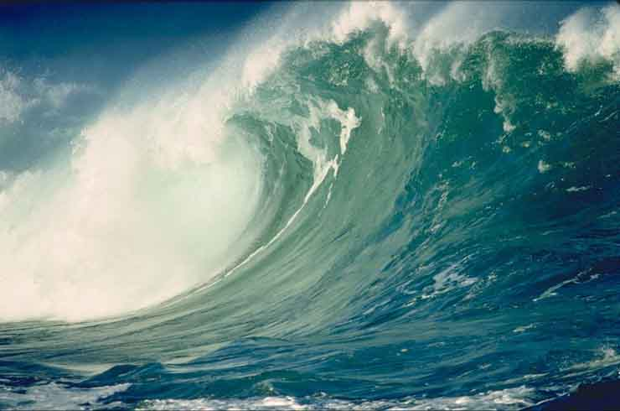
Tsunami a Wave of distraction
Heidi Reed

Slide 2
What does a tsunami mean?
In Japanese Tsunami means “harbor wave”
Tsu means “harbor”
Nami means “wave”

Slide 3
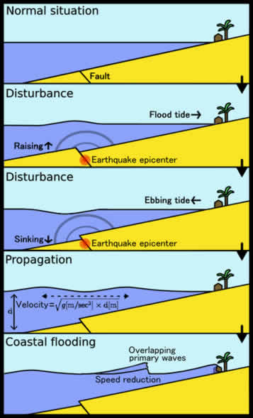
What are some of the things that cause a tsunami?
Earthquakes
Landslides
Volcanic eruptions
meteorite impacts

Slide 4
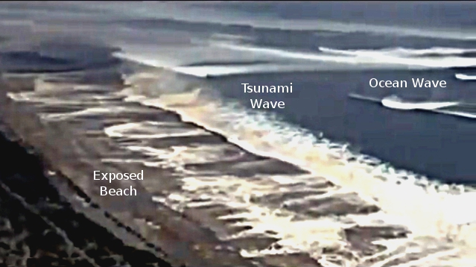
Warning Signs
When the sea draws back.

Slide 5
Feeling an earthquake.

Slide 6
Hearing an siren or an official warning.

Slide 7
Historic/future tsunamis

Slide 8
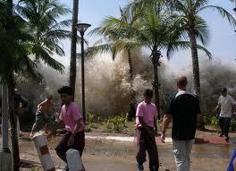
2004 Indian ocean
Deadliest: killed over 230,000
1/3 of them were young children
Caused by a mega thrust earthquake

Slide 9
1958 Lituya Bay megatsunami
Tallest tsunami wave in history.
Caused by earthquake and landside
1720 feet tall

Slide 10
La Palma mega tsunami
A possible threat

Slide 11
What not to do
Don’t go to beach
When one was issued don’t start packing your kit
Don’t go to higher ground by car
Go back because you forgot something
Sleep
Pack your most valuables
Go back after first wave
don't panic
http://home.teleport.com/~tmorse/Pages/Tsunami_Top_10.pdf

